Slide 1
CLUSTERING!
SPATIAL or Otherwise

Slide 2
Foreword
Focus on concepts and developing a working knowledge…very little math
PLEASE stop me if something isn’t clear

Slide 3
Layout for today
Clustering spatial data (using Gaussian Mixture Models)
Transition from spatial to temporal data
Clustering temporal data (using Hidden Markov Models)

Slide 4
2 Types of Data with Categories
Types of data:
Temporally Independent (Spatial)
Temporally Dependent

Slide 5
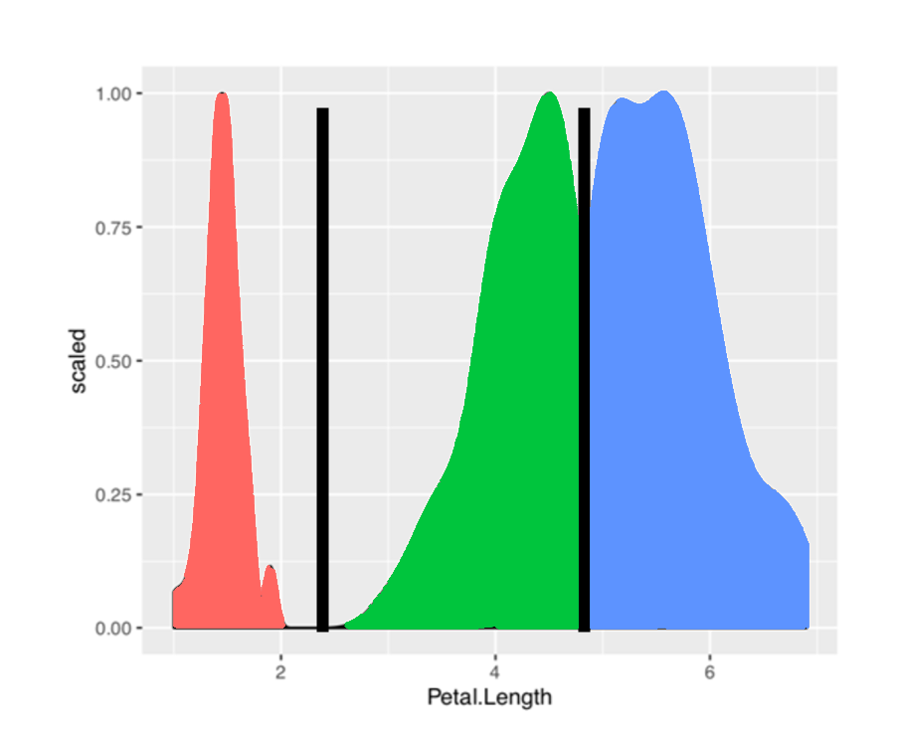
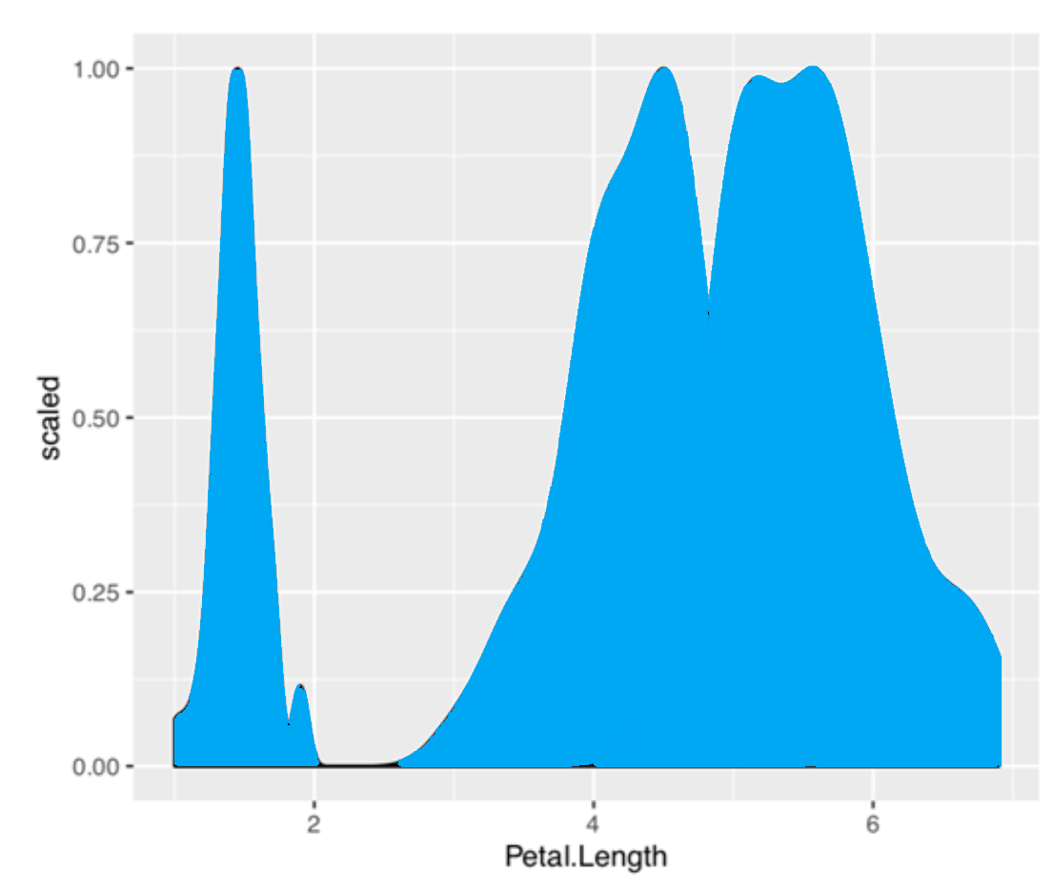
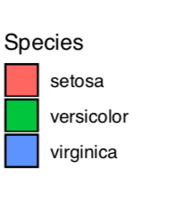
Temporally Independent Data
1.5
4.0
6.1
1.1
6.8
3.7
6.6
5.9
Order of Datapoints
Petal Length
Notes:
No temporal dependency…you can fully explain the data without having to worry about time
If I shuffle all the datapoints, I still get these distributions

Slide 6
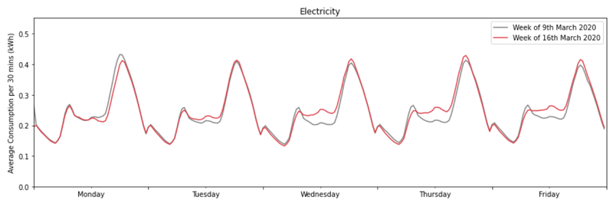
Temporally Dependent Data
Temporal Sequence
0.30 | 0.32 | 0.35 | 0.4 | 0.37 | 0.33 | 0.30 | 0.27
Notes:
Cant’ shuffle any datapoint here…have to be mindful of the temporal order

Slide 7
Spatial Clustering!

Slide 8
K-Means
Why is K-Means good:
Simple
Computationally Fast
Easy to interpret
Why is K-Means bad:
Simple
Too many assumptions about that data
Equal Variance in all dimensions → Fitting circles/spheres of equal size to data
Makes it improper to fit on more “expressive” data

Slide 9
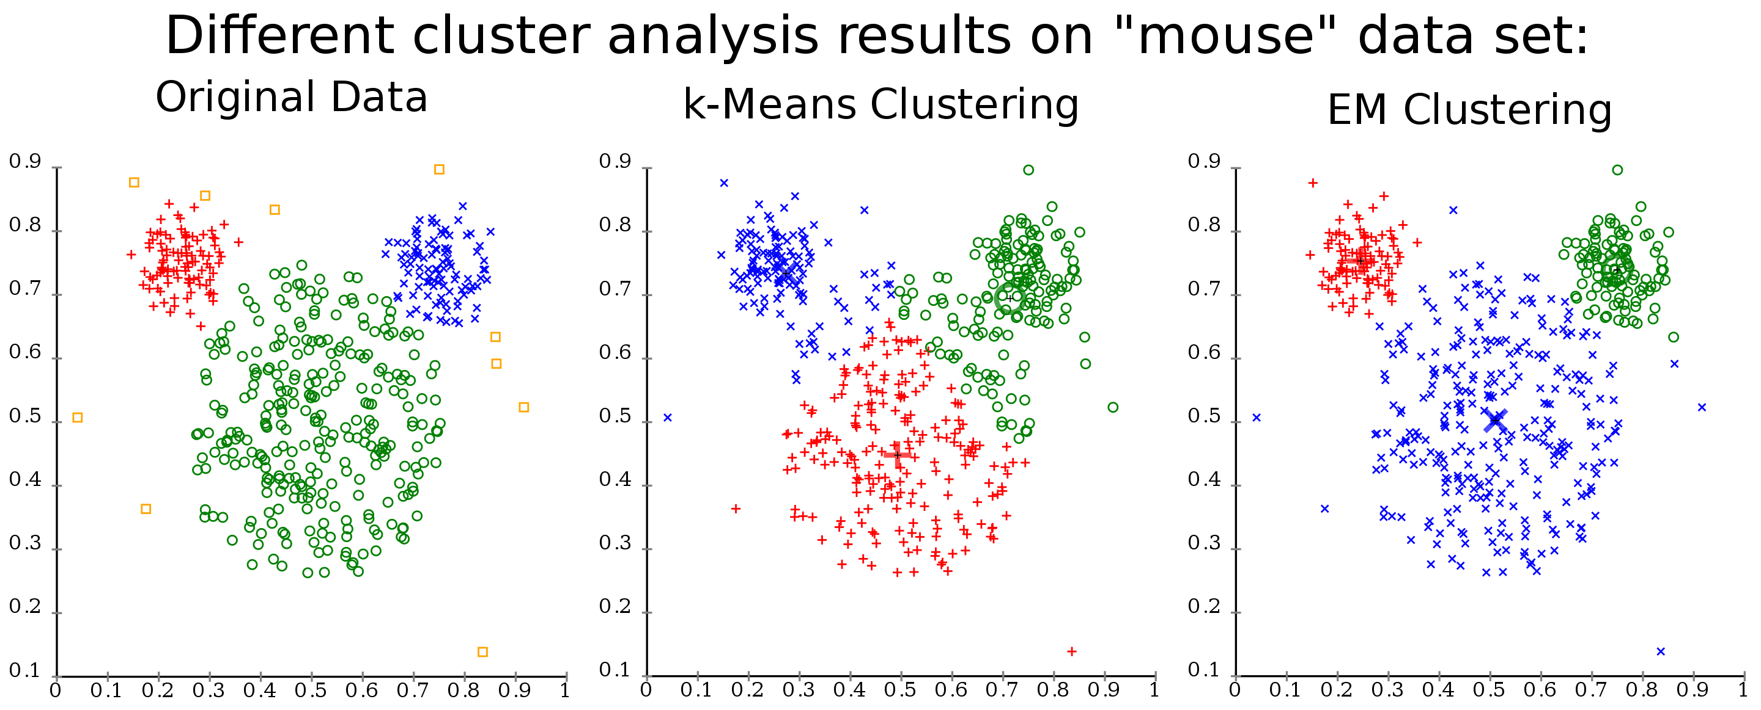
https://en.wikipedia.org/wiki/K-means_clustering
Notes:
How do we deal with differing variances?

Slide 10
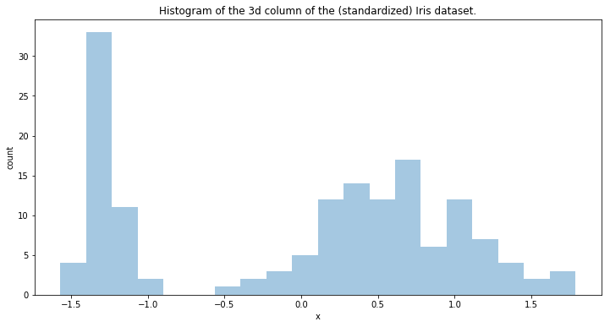
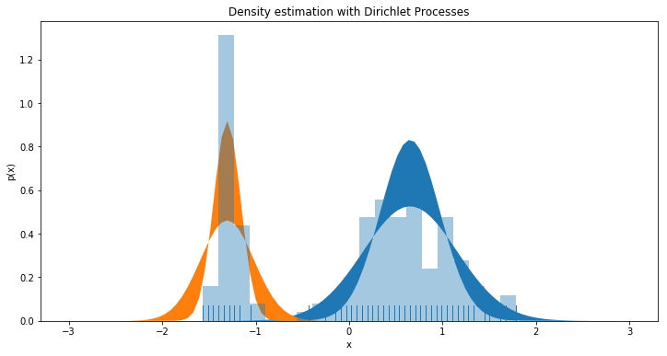
1D Gaussian Mixture Model (GMM)
2 Components
https://www.ritchievink.com/blog/2018/06/05/clustering-data-with-dirichlet-mixtures-in-edward-and-pymc3/

Slide 11
2D Gaussian Mixture Model (GMM)
GMM
https://en.wikipedia.org/wiki/K-means_clustering

Slide 12
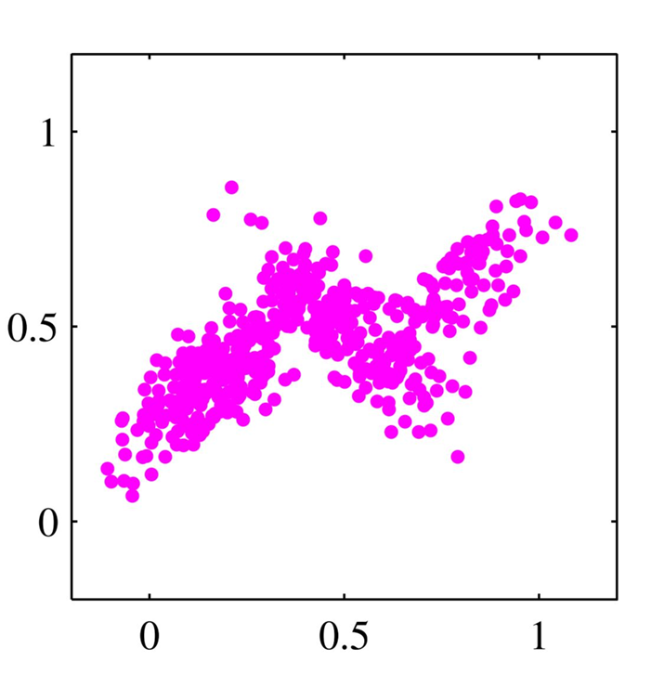
What if our data are not spherical?
(Bishop, 2006)

Slide 13
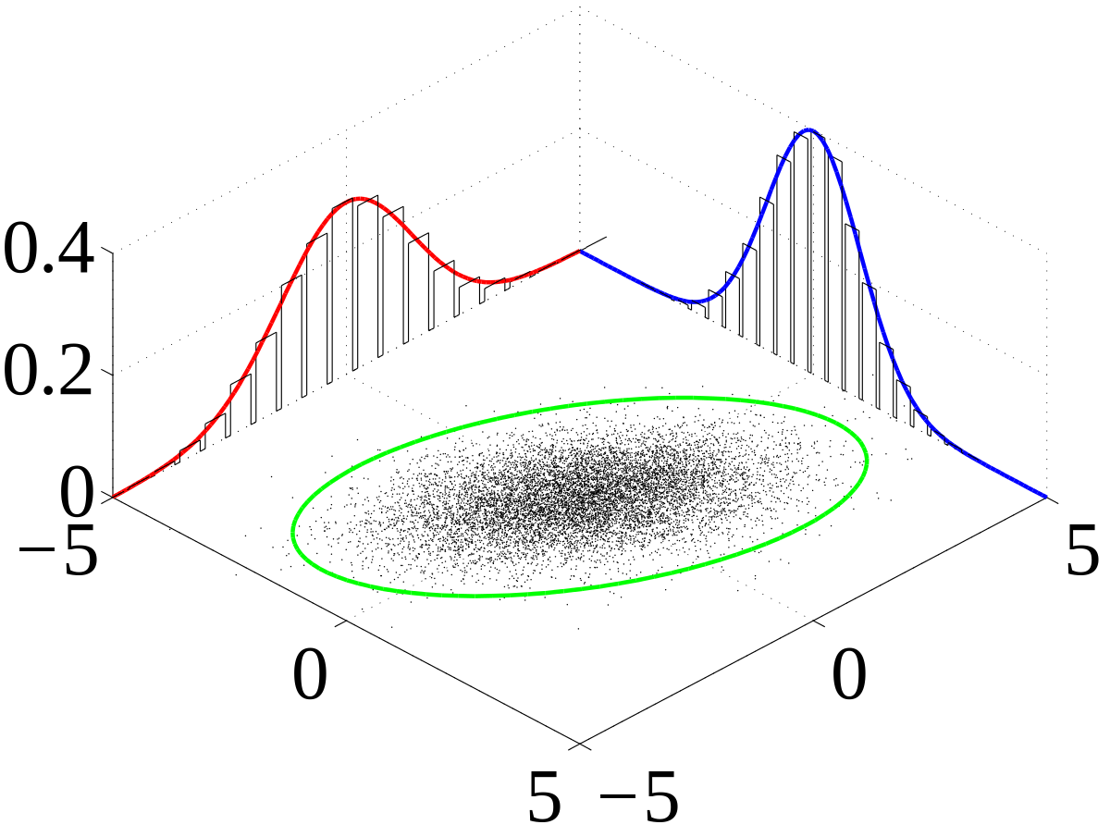
Covariance in Multivariate Gaussians
Wikipedia : Multivariate Gaussians
Notes:
Gaussians can be titled…or they can “co-vary”

Slide 14
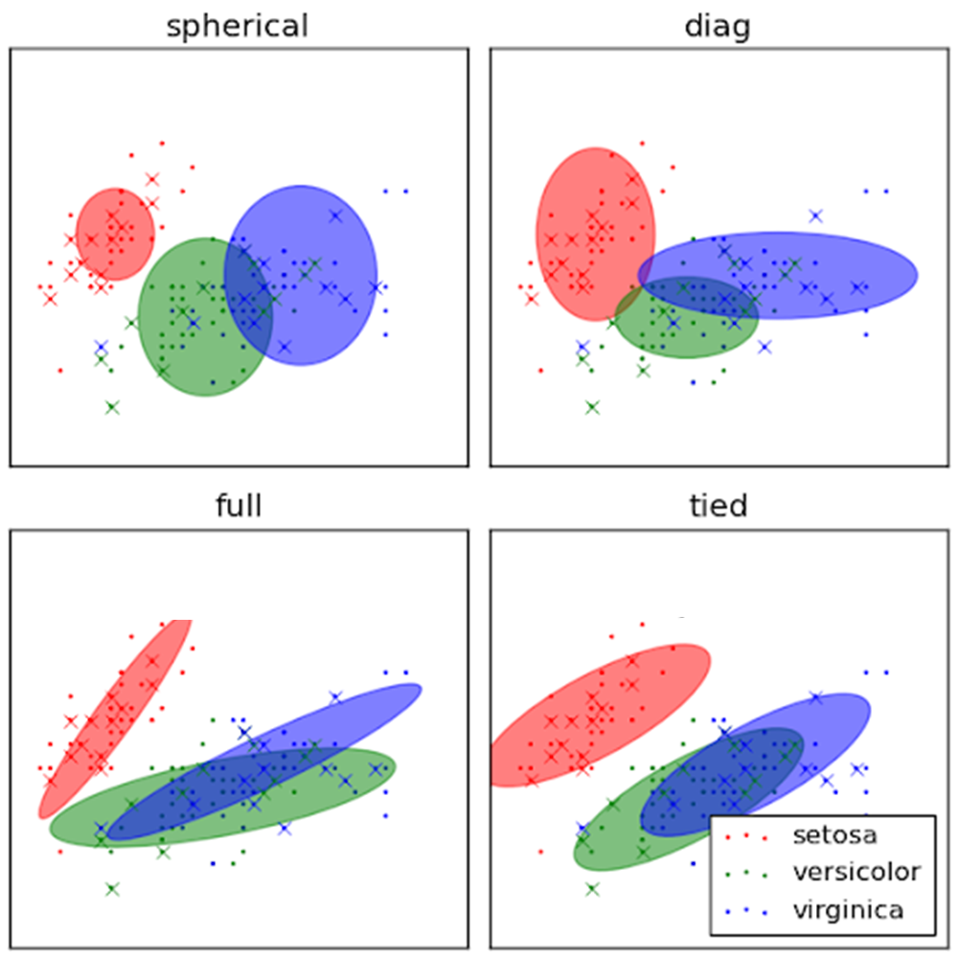
Flavors of GMM (Types of Covariances)

Slide 15
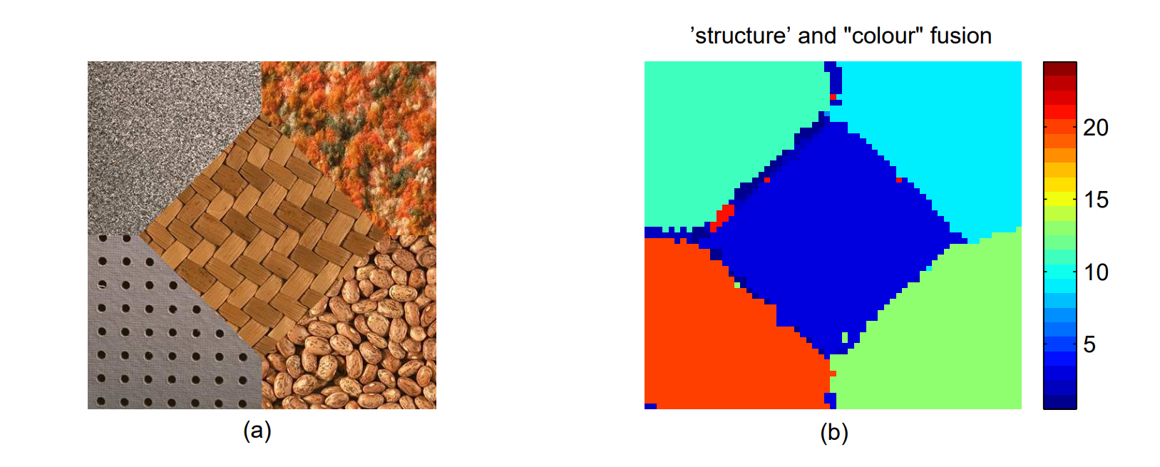
Image Segmentation
Permuter et al., 2006

Slide 16
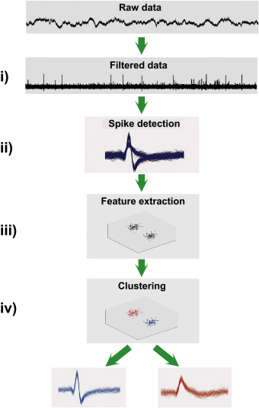
Practical Application : Spike Sorting
(Rey et al., 2015)
Notes:
The reason we can use a GMM, is because this is NOT “really” temporally dependent data
Or we can treat the datapoints in an independent way

Slide 17
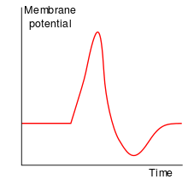
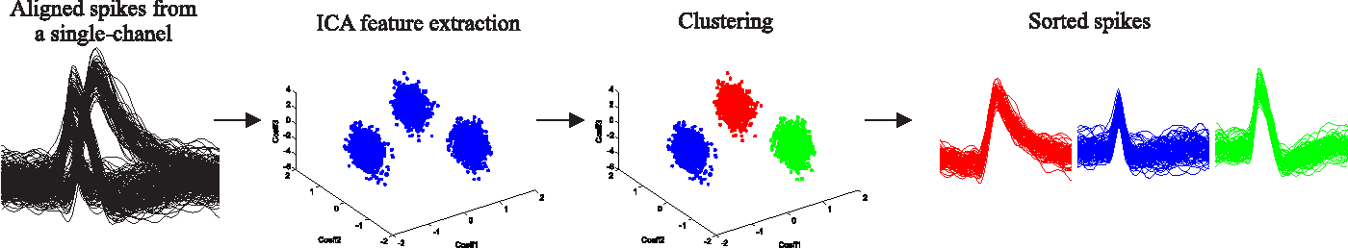
Why is this not temporal data?
1 | 1 | 1 | 3 | 9 | 5 | -1 | 0 | 1 | 1
Order of Datapoints
Single 10-Dimensional Datapoint
Notes:
Each row is 1 datapoint
Spatializing time → Don’t really care about the order of the waveforms

Slide 18
Spatial Clustering of Spike Waveforms
PCA
(Lopes et al., 2013)
Notes:
Then what does temporal modeling actually look like? Can we do this with ALL TEMPORAL DATA?
Let’s look at some temporal data and see what’s different

Slide 19
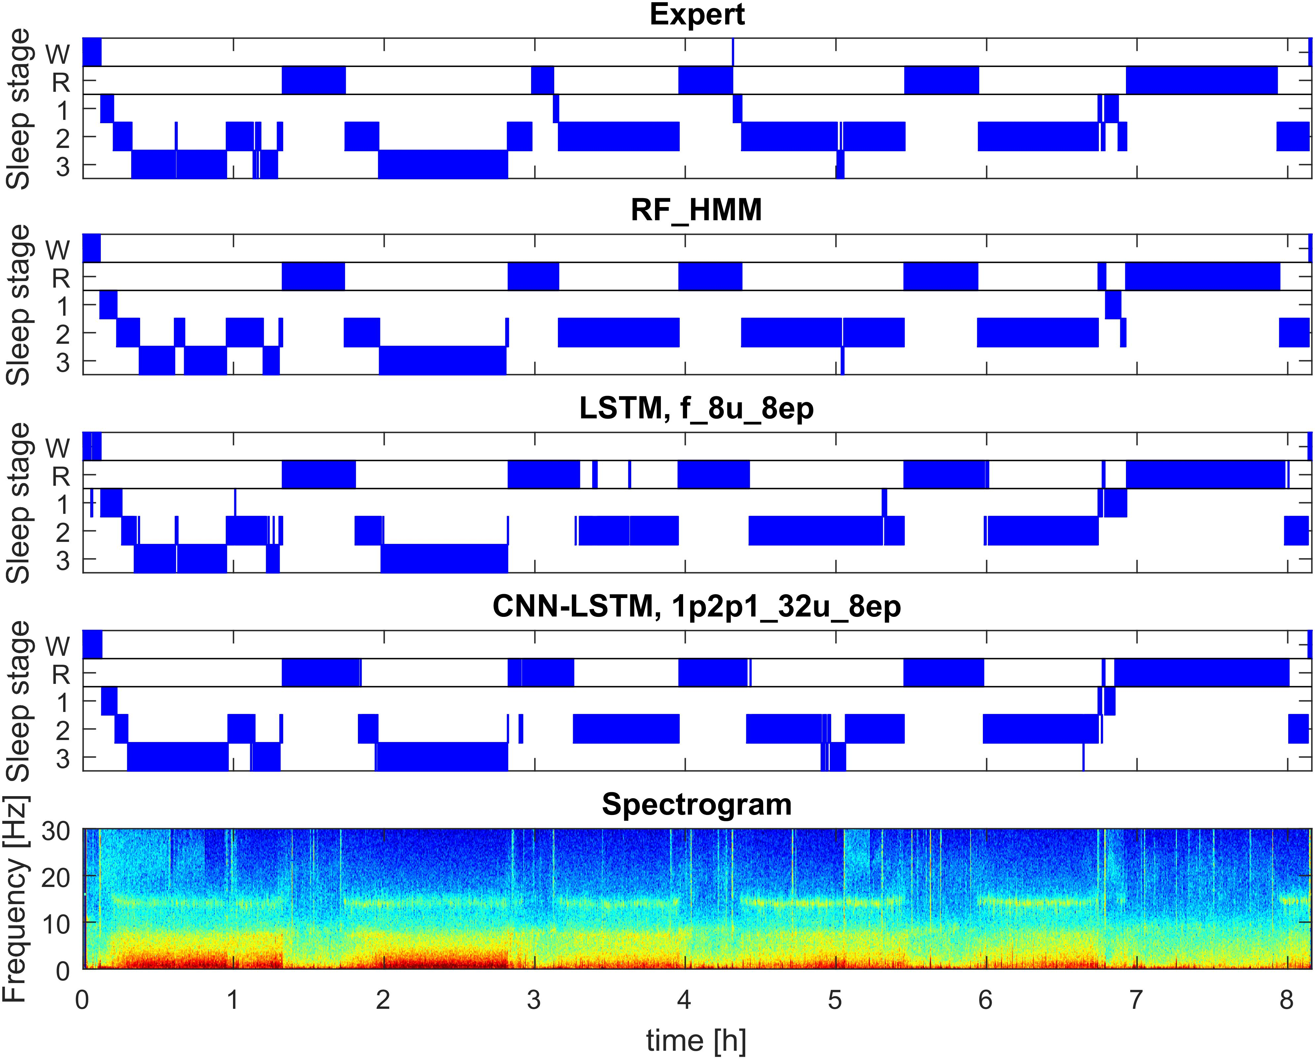
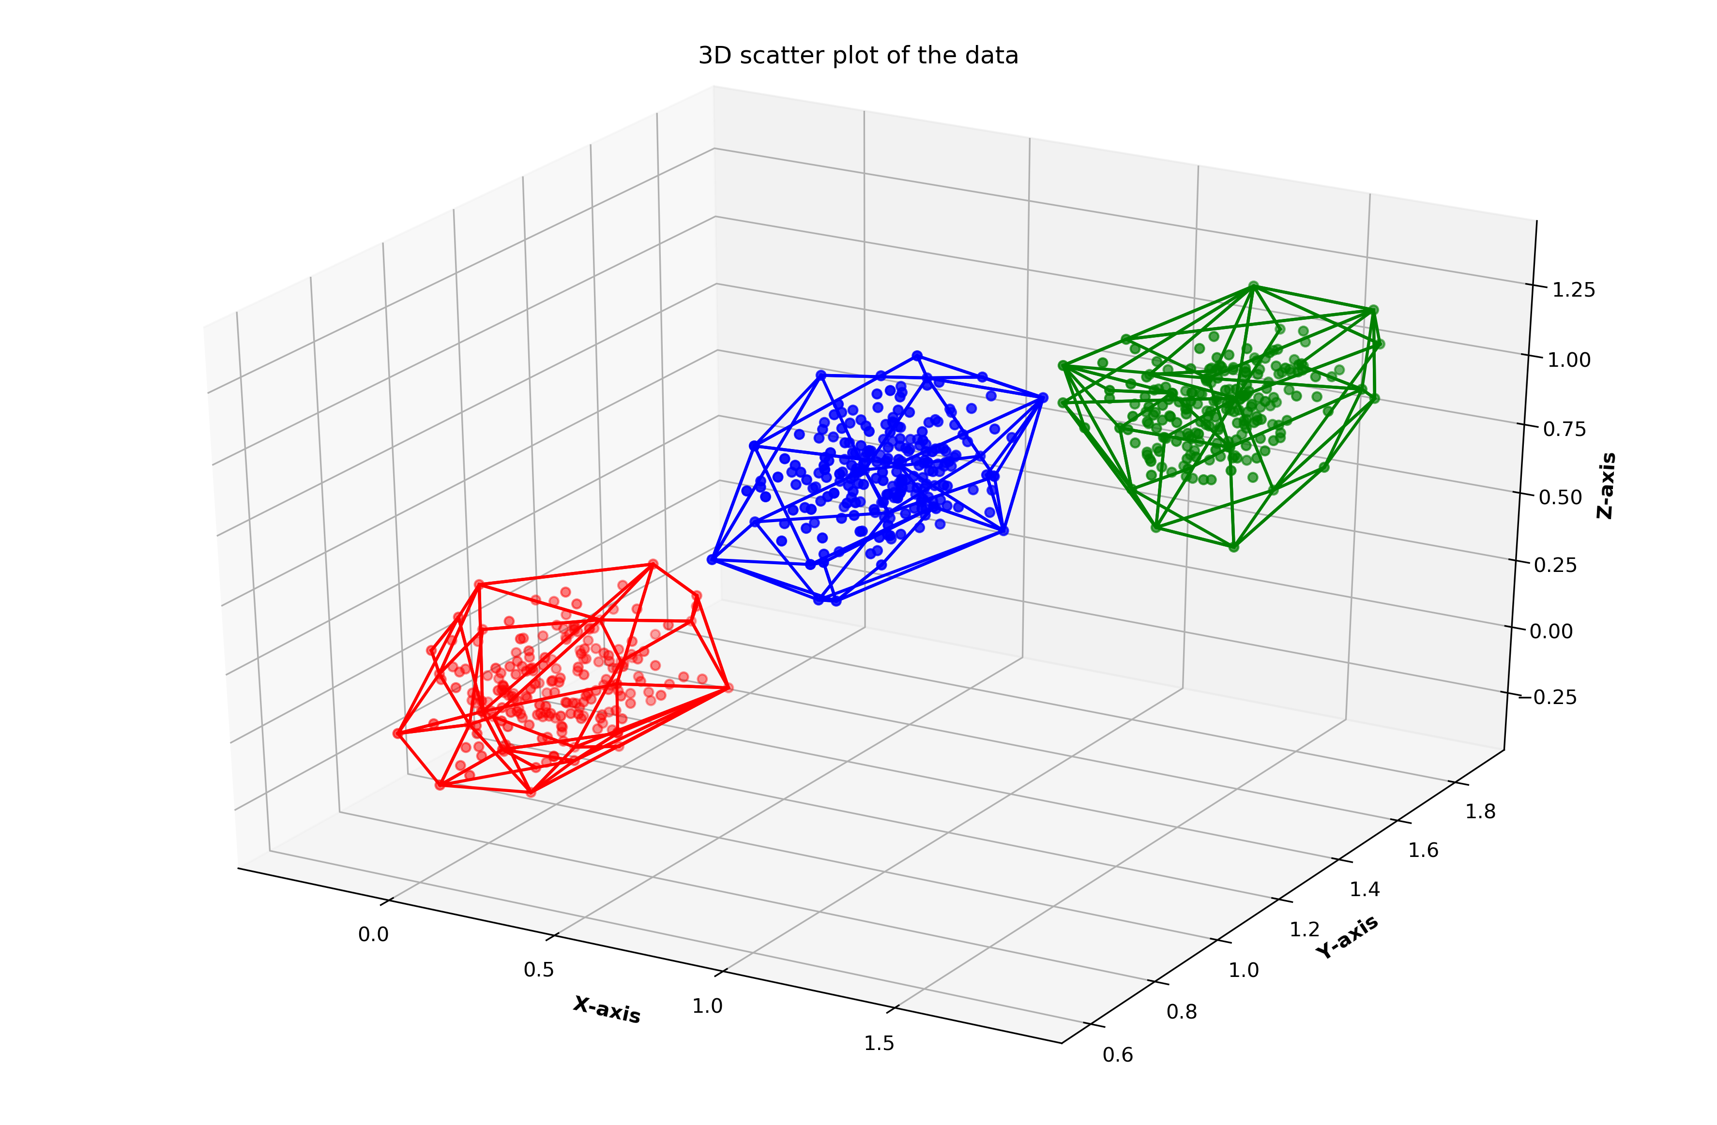
What about patterns in time?
Power
1
3
7
15
20
23
PCA and Plot
(Malafeev et al., 2018)
Notes:
Even though you can cluster timepoints spatially…that will not give you any information about the relationship between timepoints
So useless if you’re trying to find out temporal dynamics in the data
It also helps the model fit better. If it knows it can cluster together adjacent timepoints, it makes your model more powerful
So how do we model time?

Slide 20
Adjacent time-points are (almost always) not independent
Once in a state, you’re more likely than chance to stay in that state
Notes:
Applies to all time-series with “STATES”
One model that can do this is a Hidden Markov Model
Exactly what a Hidden Markov Model, models
Try to understand the difference between an HMM and a GMM

Slide 21
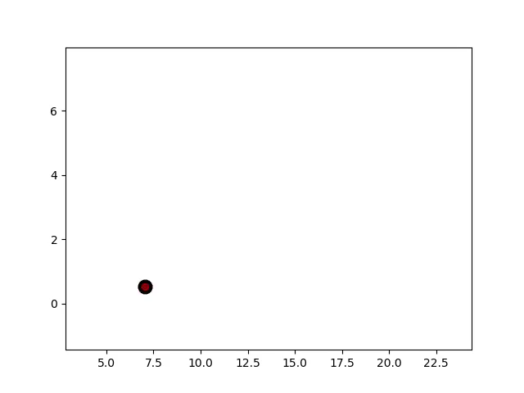
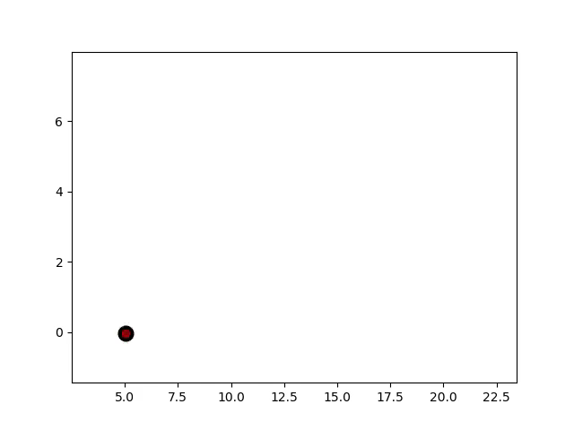
How do GMMs vs HMMs think : Generative Process
Gaussian Mixture
Hidden Markov
Deep dive : https://maelfabien.github.io/machinelearning/GMM/
Notes:
Can reverse GMMs and HMMs and that gives you an idea of how they perceive the data
The ONLY thing I want you to take away from this is that HMMs care about time spent in a cluster
I’ll explain why this is a gaussian HMM in the next slide

Slide 22
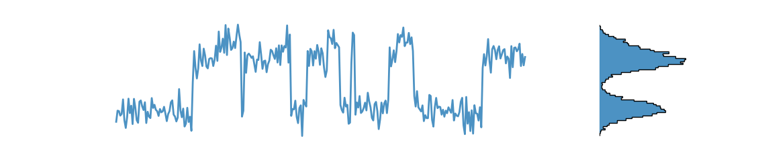
Gaussian HMM
1
3
7
15
20
23
Notes:
HMMs can find states in many different types of data
The kind of HMM depends on the data we’re using

Slide 23




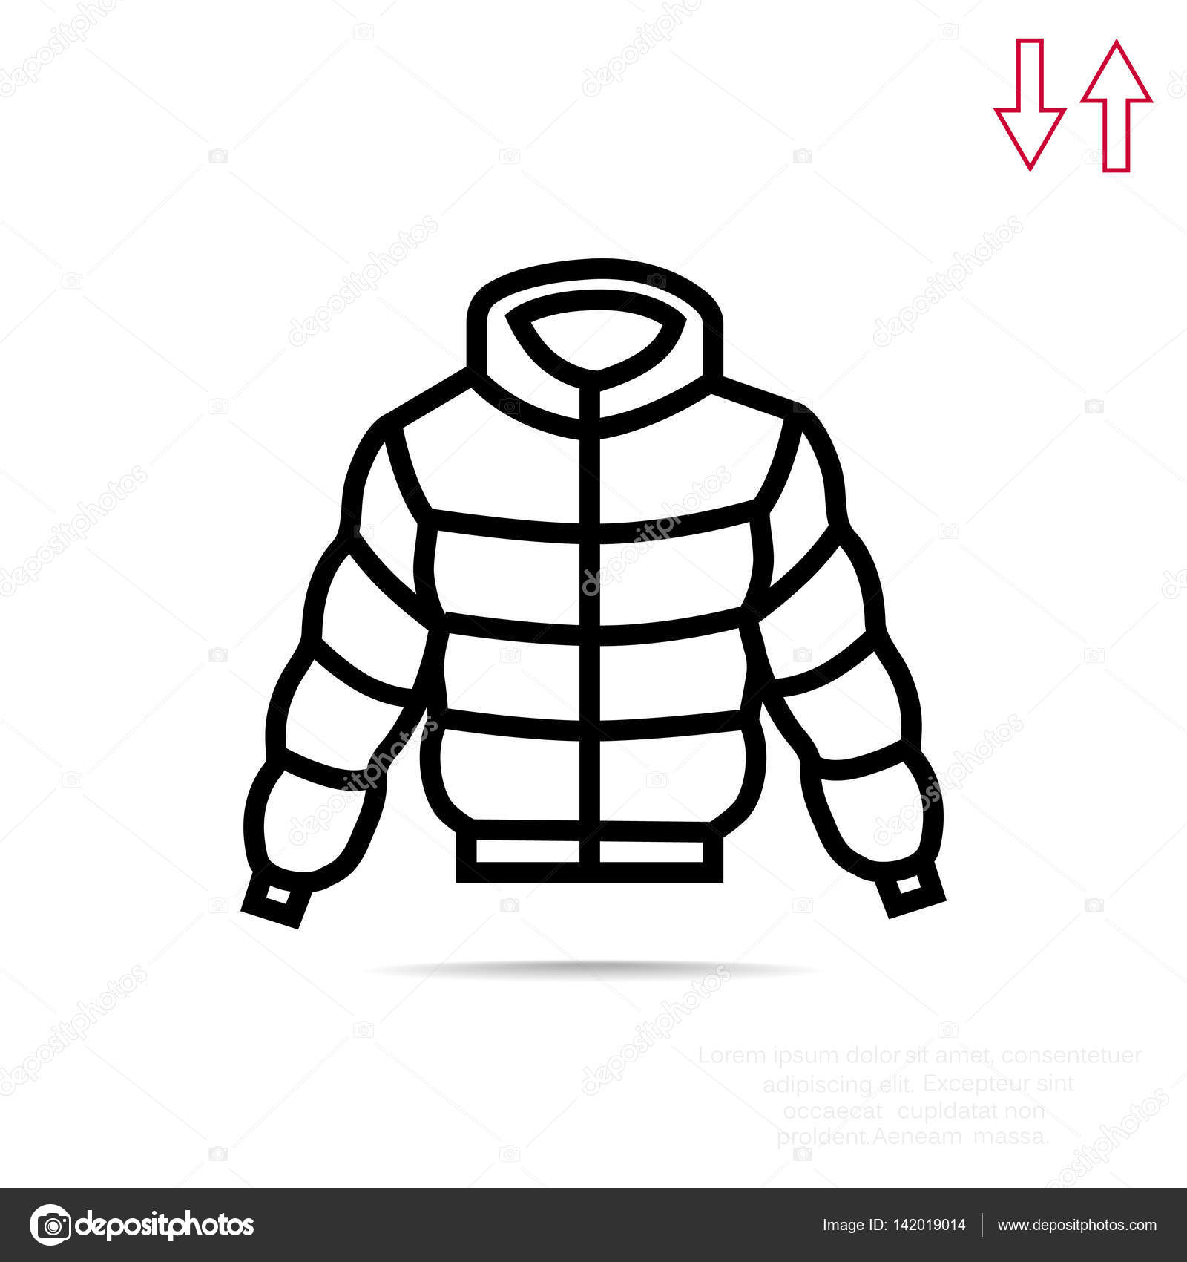
Categorical HMM
Rainy
1 | 2 | 3 | 4 | 2 | 1 | 5
Sunny
0
1
0
0
0
2
Days
Notes:
We know that weather persists for a couple days. So the weather of one day is related to the weather of days around it

Slide 24
HMM : The Model (Bottom-Up Building)
Rainy
0.4
Sunny
0.6
0.8
0.2
0.37 | 0.33 | 0.09 | 0.18 | 0.01
0.07 | 0.03 | 0.36 | 0.51 | 0.01
Notes:
Let’s build backwards
The model doesn’t understand the meaning of the states…they’re just variables for it

Slide 25
HMM Emissions : Categorical
Rainy
Sunny

Slide 26
HMM : Model Parameters
Emission Matrix
Transition Matrix
To this state
How much of each category?
Rainy
Sunny
0.6 | 0.4
0.2 | 0.8
Sunny
0.07 | 0.03 | 0.36 | 0.51 | 0.01
0.37 | 0.33 | 0.09 | 0.18 | 0.01
State
Rainy
Sunny
Rainy
Go from this state

Slide 27
(Brief) Code Walkthrough
I like plotting and printing
Can turn off on top of script
All in MATLAB
MATLAB HMM is Categorical…but all HMMs are NOT
Different algorithms to find model parameters (Emission and Transition matrices), and to find the sequence of states in the data (Posterior Decoding).

Slide 28
Determining Best Parameters
How do we determine number of clusters in GMM, or number of states in HMM
Mean Squared Error? Variance Explained (R^2)?
Models with more parameters will ALWAYS perform better (but at what cost)
Akaike Information Criterion
Compares “Goodness of Fit” with number of parameters
AIC penalizes models by how many parameters they have
Fit models with a range of clusters/states. Model with lowest AIC “should” be best
Doesn’t always work that great ☹
Cross-validation
Train on a subset of the data and testing on a “held-out” subset (new data)
Not explored today

Slide 29
References
Bishop, C. M. (2006). Pattern recognition and machine learning. Springer.
Chen, X., Qiu, X., Jiang, J., & Huang, X. (2015). Gaussian mixture embeddings for multiple word prototypes. ArXiv:1511.06246 [Cs]. http://arxiv.org/abs/1511.06246
Lopes, M. V., Aguiar, E., Santana, E., Santana, E., & Barros, A. K. (2013). ICA feature extraction for spike sorting of single-channel records. 2013 ISSNIP Biosignals and Biorobotics Conference: Biosignals and Robotics for Better and Safer Living (BRC), 1–5. https://doi.org/10.1109/BRC.2013.6487468
Malafeev, A., Laptev, D., Bauer, S., Omlin, X., Wierzbicka, A., Wichniak, A., Jernajczyk, W., Riener, R., Buhmann, J., & Achermann, P. (2018). Automatic human sleep stage scoring using deep neural networks. Frontiers in Neuroscience, 12. https://doi.org/10.3389/fnins.2018.00781
Permuter, H., Francos, J., & Jermyn, I. (2006). A study of Gaussian mixture models of color and texture features for image classification and segmentation. Pattern Recognition, 39(4), 695–706. https://doi.org/10.1016/j.patcog.2005.10.028
Rey, H. G., Pedreira, C., & Quian Quiroga, R. (2015). Past, present and future of spike sorting techniques. Brain Research Bulletin, 119, 106–117. https://doi.org/10.1016/j.brainresbull.2015.04.007

